Slide 1

Market Regime Detection using Supervised
Professor: Yue Gao
Date: 12/01/2025
Pragathi Somashekaraiah
Mohammad Faishal Khan
Narayan Rijal
Devashree Dhole
Machine Learning (STAT 4650)

Slide 2
Introduction
The U.S. stock market is the largest in the world, representing
~ 46% of global equity market capitalization.
Total U.S. market capitalization is approximately $45–50 trillion.
Major U.S. indices (S&P 500, Dow Jones, Nasdaq) drive global financial sentiment.

Slide 3
Market Regime Detection
Why Detect Regimes
Identifying regime shifts early can prevent large drawdowns.
Traditional methods struggle with sudden market reversals.
Role of Machine Learning
Processes multiple indicators simultaneously (e.g., volatility, yield curve, bond-equity ratios)
Learns historical transition patterns between market regimes

Slide 4
Problem Statement
Can supervised ML models accurately classify bull vs bear market regimes using pre-market indicators?
Which financial features (VIX, yield curve, TLT/SPY ratio) are most predictive of market regimes?
How can regime classification improve risk-aware decision-making strategies for investors

Slide 5
Data Description
Data Sources
Yahoo Finance: SPY, VIX, TLT
FRED: 10Y–3M Treasury spread
VIX Index: Captures market fear and volatility
TLT ETF: Represents Treasury bond performance and risk-off behavior
Yield Curve (10Y–3M spread): Indicates macroeconomic conditions
Merged Dataset: ~5,800 trading days from 2000–2023
SPY ETF: Used to label bull vs bear regimes via 200-day moving average

Slide 6
Descriptive Statistics
Feature | Bear (0) Mean | Bear Median | Bear Std | Bull (1) Mean | Bull Median | Bull Std | Min | Max
VIX | 31.39 | 26.40 | 13.26 | 17.93 | 16.23 | 6.48 | 9.14 | 82.69
Yield Curve | 1.76 | 2.00 | 0.89 | 1.35 | 1.50 | 1.37 | -1.89 | 3.85
Credit Spread | 838.45 | 588.66 | 450.69 | 1012.27 | 1033.81 | 404.63 | 321.24 | 1842.53
TLT/SPY Ratio | 0.560 | 0.553 | 0.262 | 0.513 | 0.531 | 0.187 | 0.13 | 1.28
SPY Daily Return (%) | -0.257 | -0.1245 | 2.289 | 0.078 | 0.0824 | 0.980 | -11.59 | 13.56
Bear periods have much higher VIX, lower yield curve, wider credit spreads, and higher TLT/SPY ratio.
SPY returns sharply decline during Bear regimes (mean = -0.26%) vs positive in Bull markets.

Slide 7
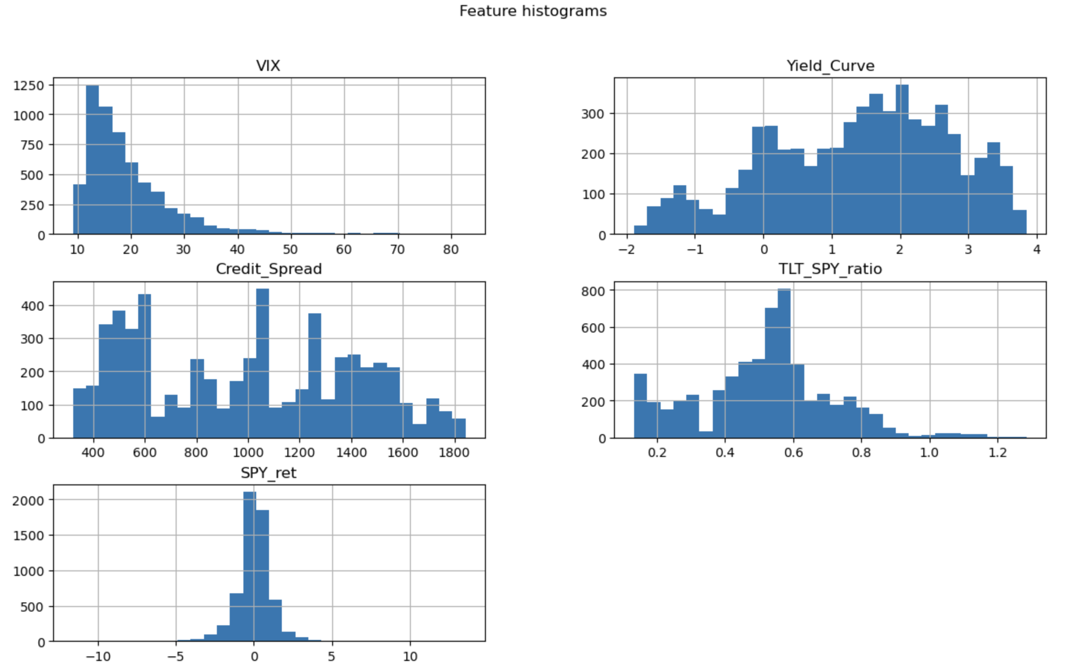
Histogram

Slide 8
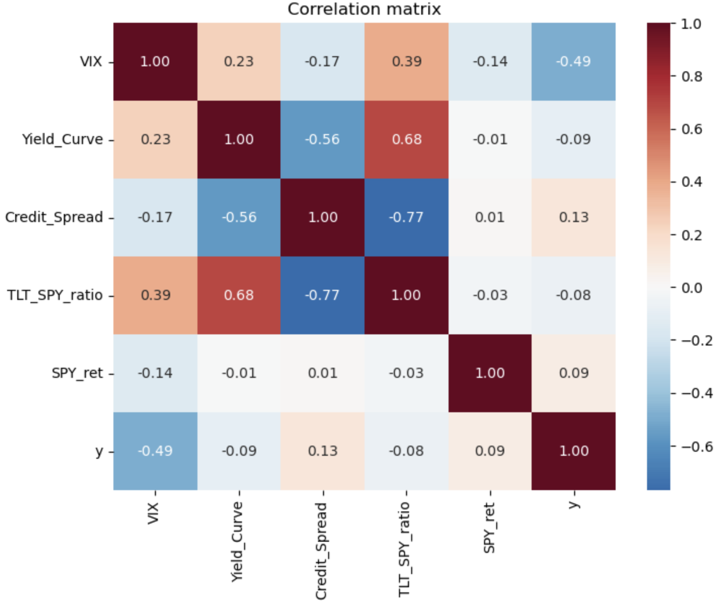
Heatmap Correlation

Slide 9
Methods
Built dataset from SPY, VIX, TLT, and yield curve data.
Created target variable y = Market Regime (0 = Bear, 1 = Bull)
Trained ML models:
Logistic, Lasso Logistic, Decision Tree, Random Forest, XGBoost
Evaluated performance using accuracy, precision, recall, F1-score, and ROC-AUC.
Split dataset into training and testing and validation ( Train [2002–2018]: 60 ; Test[2019–2021]: 20 ; Validation [2022–2025] : 20 ).
Handled class imbalance in the training data using SMOTETomek.

Slide 10
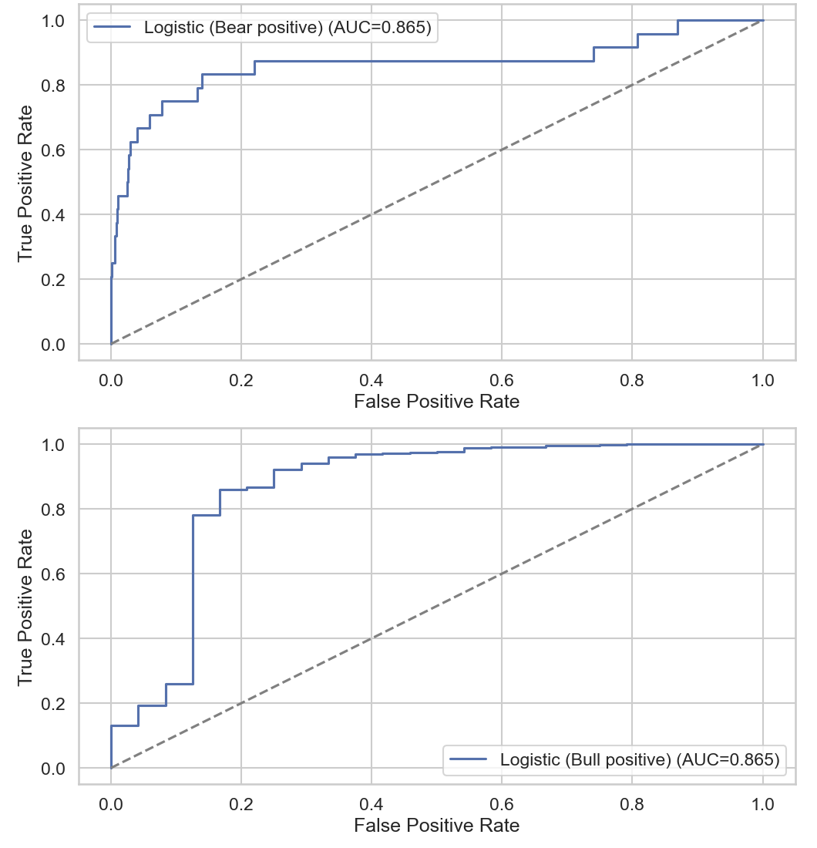
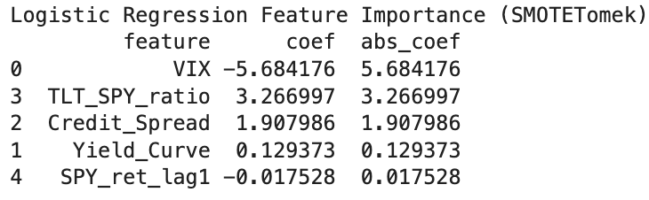
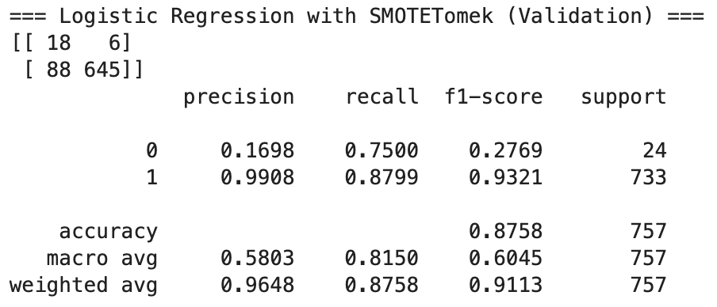
Logistic Regression with SMOTE-Tomek

Slide 11
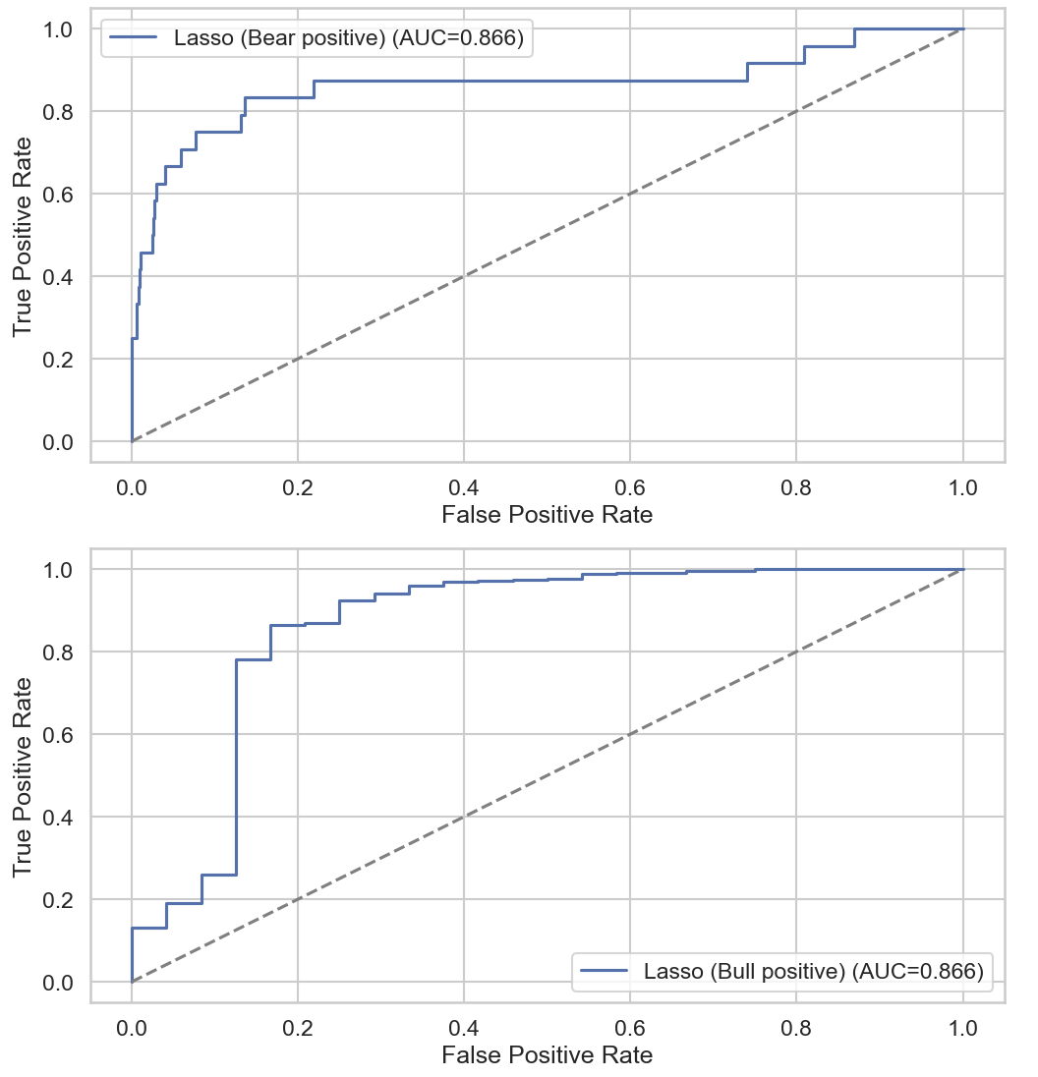
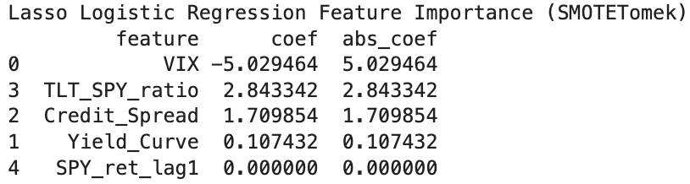
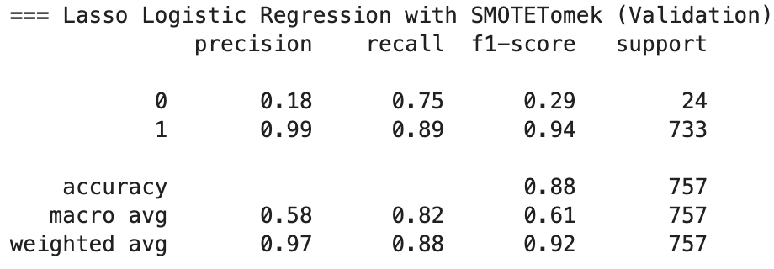
Lasso Logistic Regression with SMOTE-Tomek

Slide 12
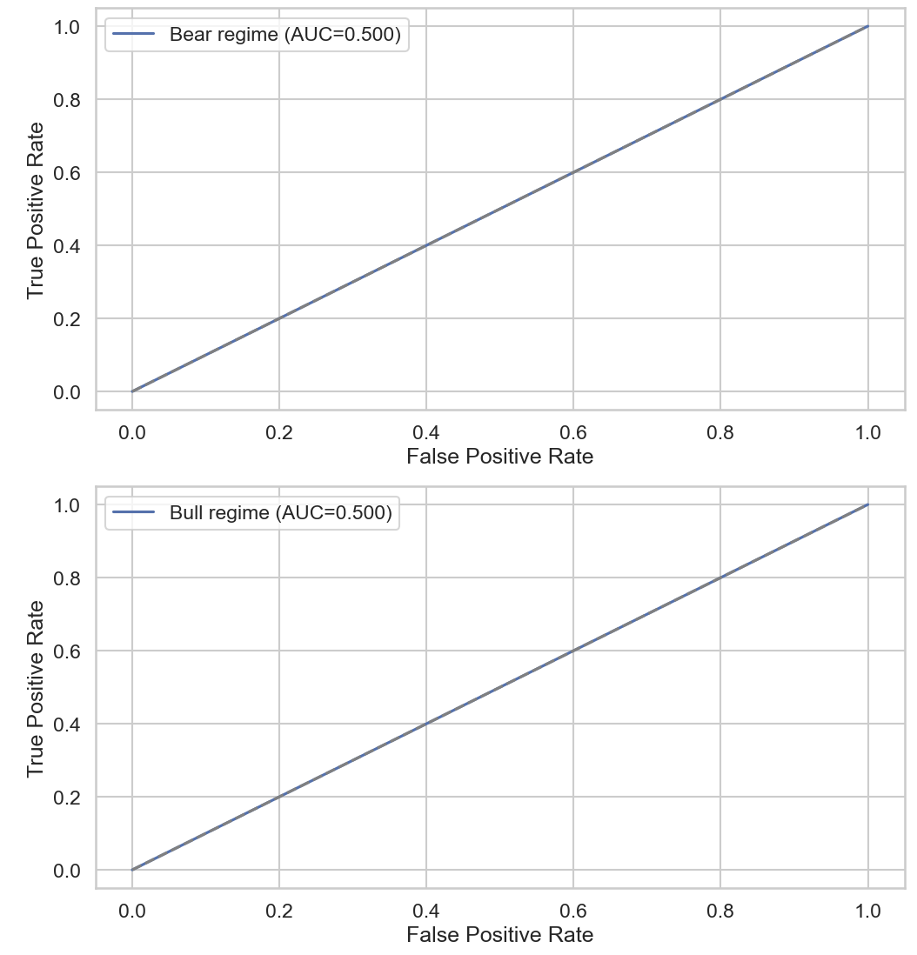
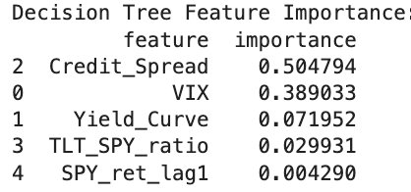
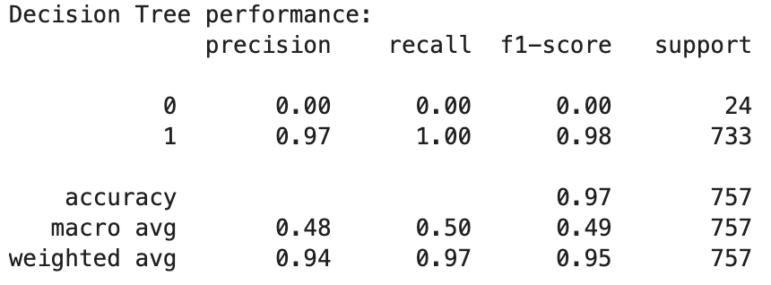
Decision Tree Model with SMOTE-Tomek

Slide 13
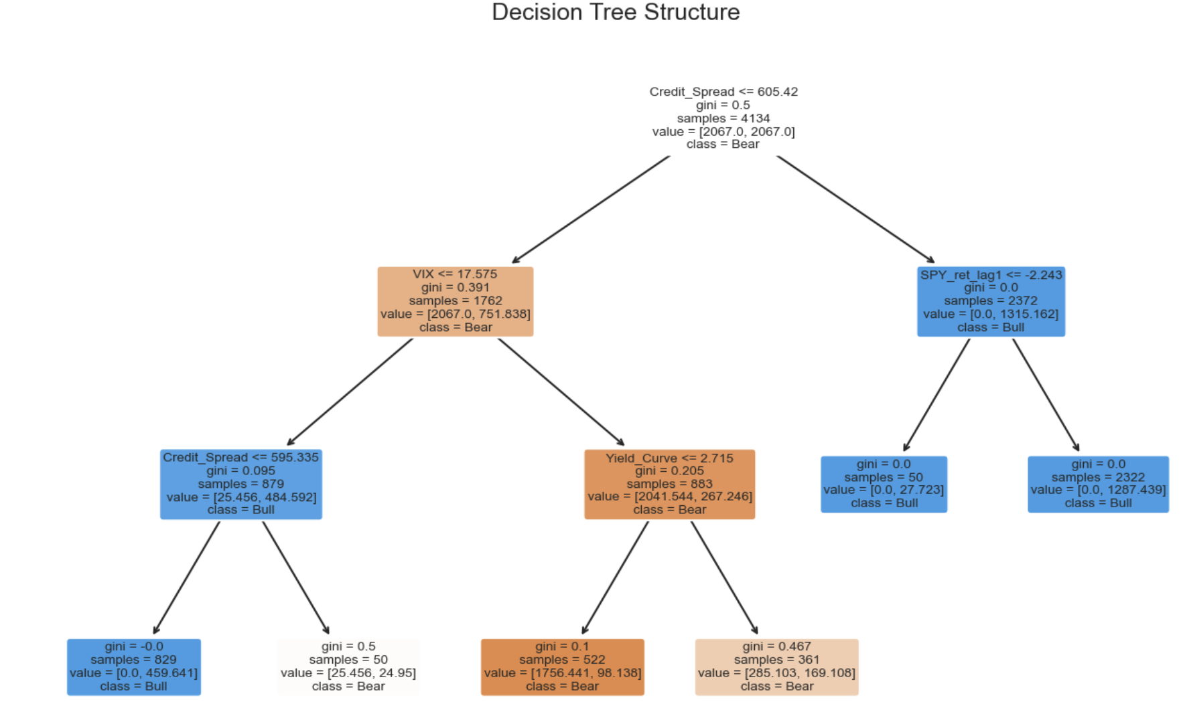
Decision Tree with SMOTE-Tomek

Slide 14
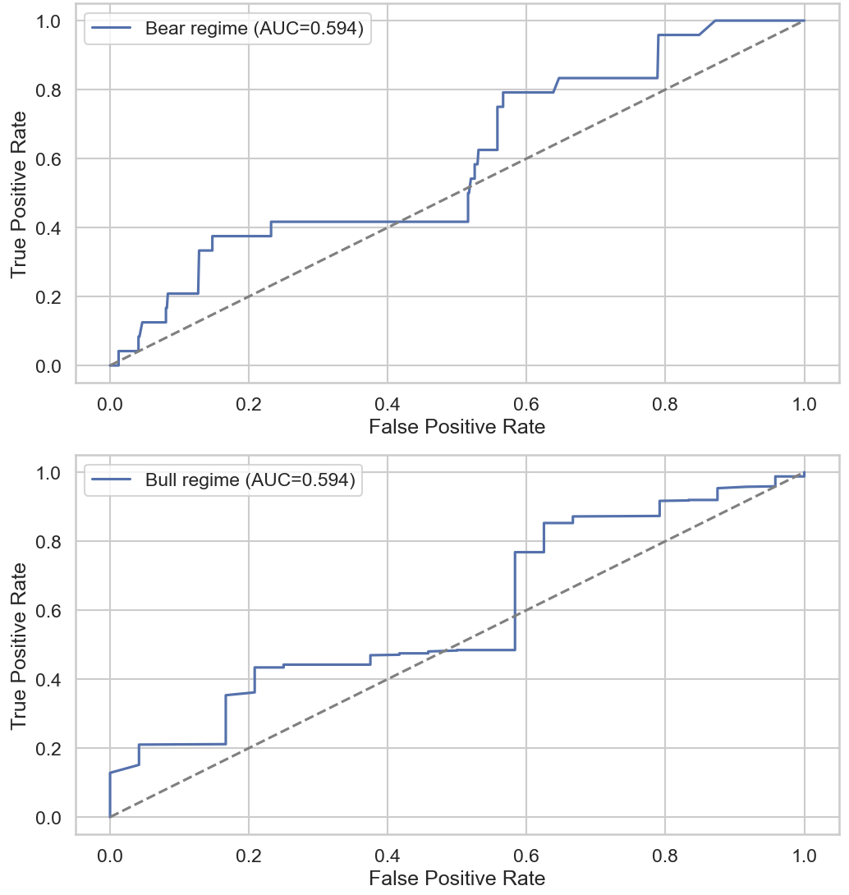
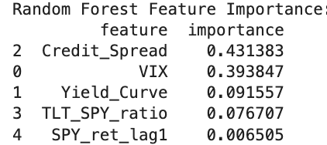
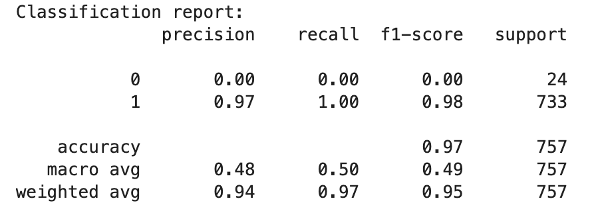
Random Forest Model with SMOTE-Tomek

Slide 15
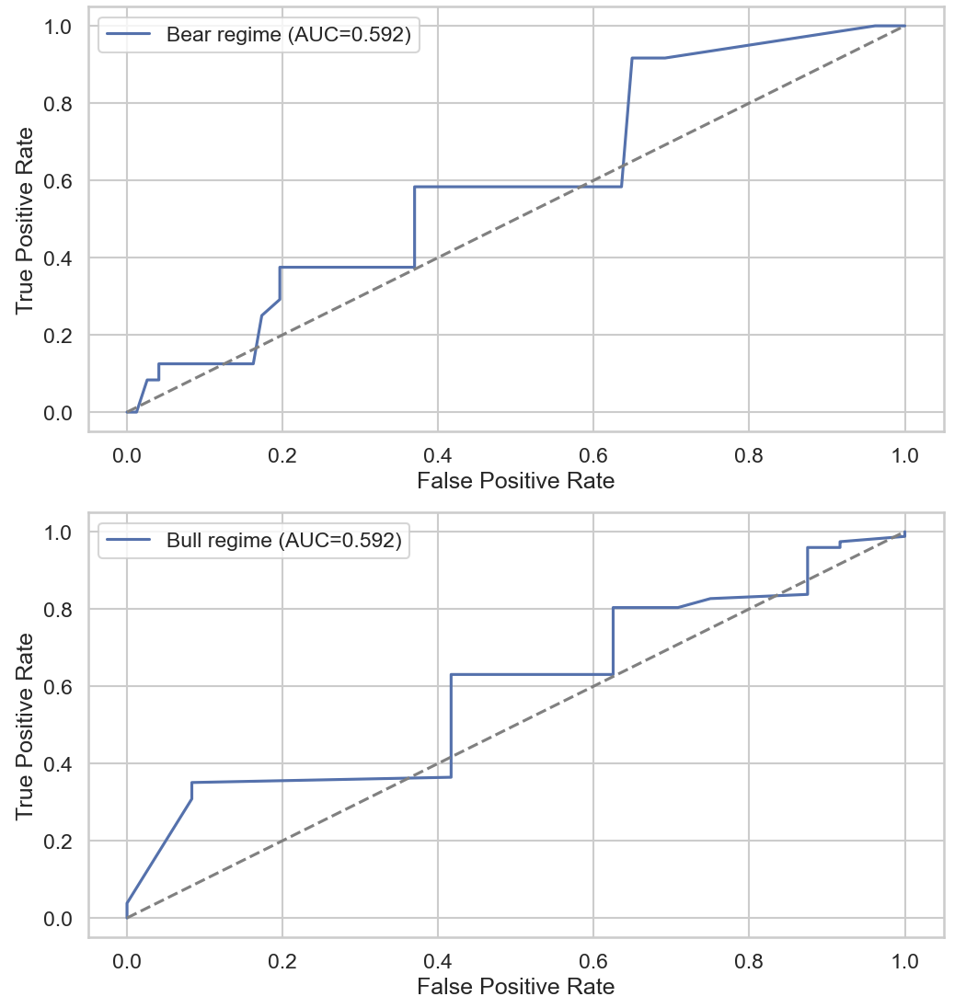
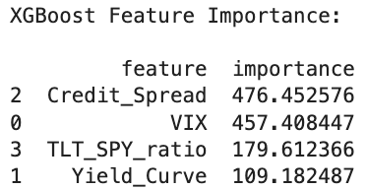
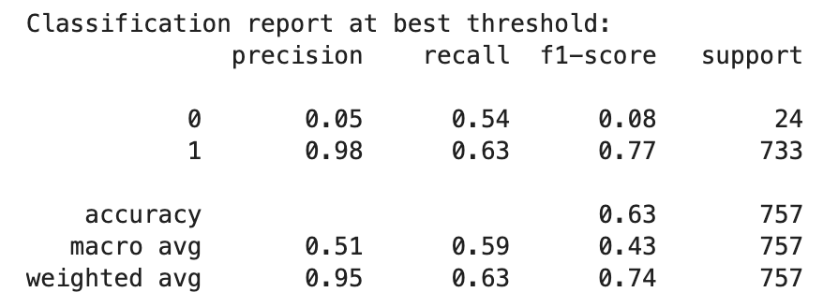
XGBoost with SMOTE-Tomek

Slide 16
Model Performance Summary Table
Model | Accuracy | Precision (Bear) | Recall (Bear) | F1 (Bear) | AUC (Bear) | Precision (Bull) | Recall (Bull) | F1 (Bull) | AUC (Bull)
Lasso Logistic | 0.86 | 0.17 | 0.83 | 0.28 | 0.87 | 0.99 | 0.86 | 0.92 | 0.87
Logistic Regression | 0.87 | 0.17 | 0.75 | 0.27 | 0.87 | 0.99 | 0.88 | 0.93 | 0.87
XGBoost (SMOTETomek) | 0.63 | 0.05 | 0.54 | 0.08 | 0.59 | 0.98 | 0.63 | 0.77 | 0.59
Decision Tree (SMT) | 0.97 | 0.00 | 0.00 | 0.00 | 0.50 | 0.97 | 1.00 | 0.98 | 0.50
Random Forest (SMT) | 0.97 | 0.00 | 0.00 | 0.00 | 0.59 | 0.97 | 1.00 | 0.98 | 0.59

Slide 17
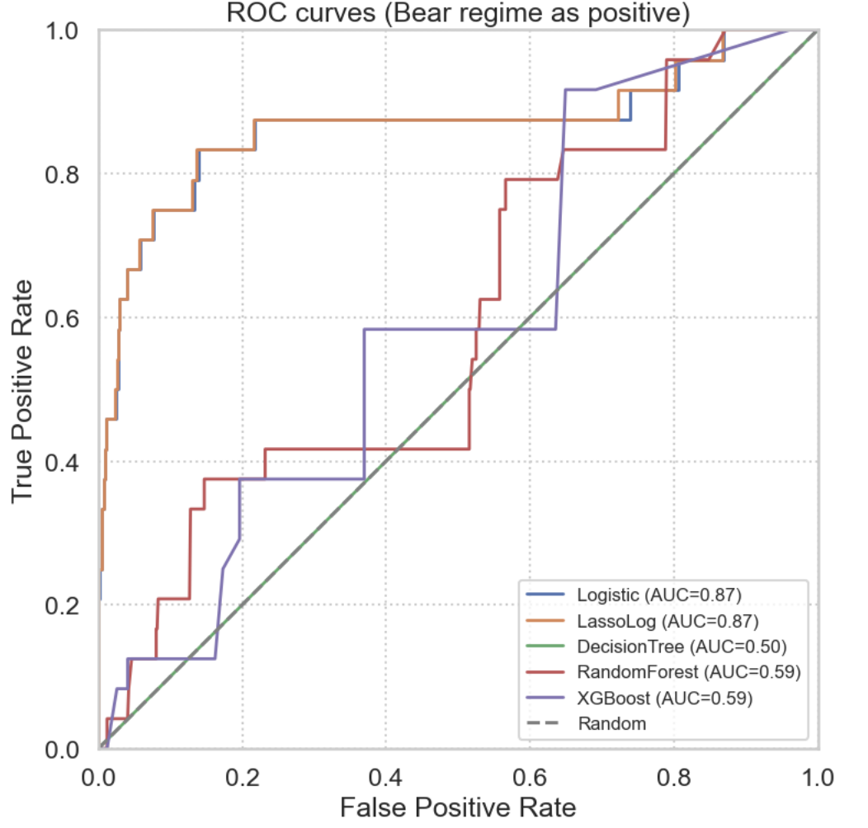
ROC - AUC for selected models

Slide 18
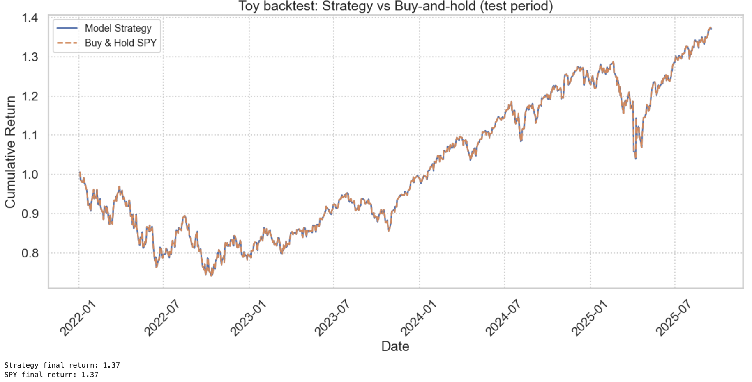
Prediction on test set using Random Forest

Slide 19
Key Findings
VIX and TLT/SPY emerged as the strongest predictors.
Yield curve added a slow-moving recession signal.
Models struggled with rare bear periods due to class imbalance.
Out-of-sample testing (2020–2025) confirmed model stability in volatile markets

Slide 20
Results
Logistic & Lasso logistic : Delivered highest recall and AUC for bear-market detection
Lasso Logistic delivered the best bear-class recall (0.83) and AUC (0.867)
Tree Models: Failed to detect bear signals due to class imbalance
Class Imbalance: Caused tree models to default to majority-class predictions

Slide 21
Discussion
Combines VIX, yield curve, credit spreads, and TLT/SPY ratio to flag regime shifts before market open.
Lasso Logistic performed best for bear detection (recall = 0.83) while remaining fully interpretable.
Helps investors reduce drawdowns by adjusting equity exposure, increasing hedging, or shifting to defensive assets early.
Provides an early-warning signal for volatility spikes and macroeconomic stress.
Supports regulators in monitoring systemic risk using transparent, explainable financial indicators.
Useful for stress-testing, liquidity monitoring, and identifying periods when markets are vulnerable.

Slide 22
Conclusion
Pre-market indicators allow early identification of market regimes, supporting faster and more informed decisions.
Regime classification strengthens risk management by helping investors adjust exposure before major downturns.
Interpretable models provide regulators with clear, real-time signals of emerging systemic stress.

